Slide 1


Lab 4
Multi-variable linear regression
With TF 1.0!
Sung Kim <hunkim+ml@gmail.com>
Code: https://github.com/hunkim/DeepLearningZeroToAll/

Slide 2

Call for comments
Please feel free to add comments directly on these slides
Other slides: https://goo.gl/jPtWNt
Picture from http://www.tssablog.org/archives/3280

Slide 3
Lab 4-1
Multi-variable linear regression
With TF 1.0!
Sung Kim <hunkim+ml@gmail.com>
Code: https://github.com/hunkim/DeepLearningZeroToAll/

Slide 4
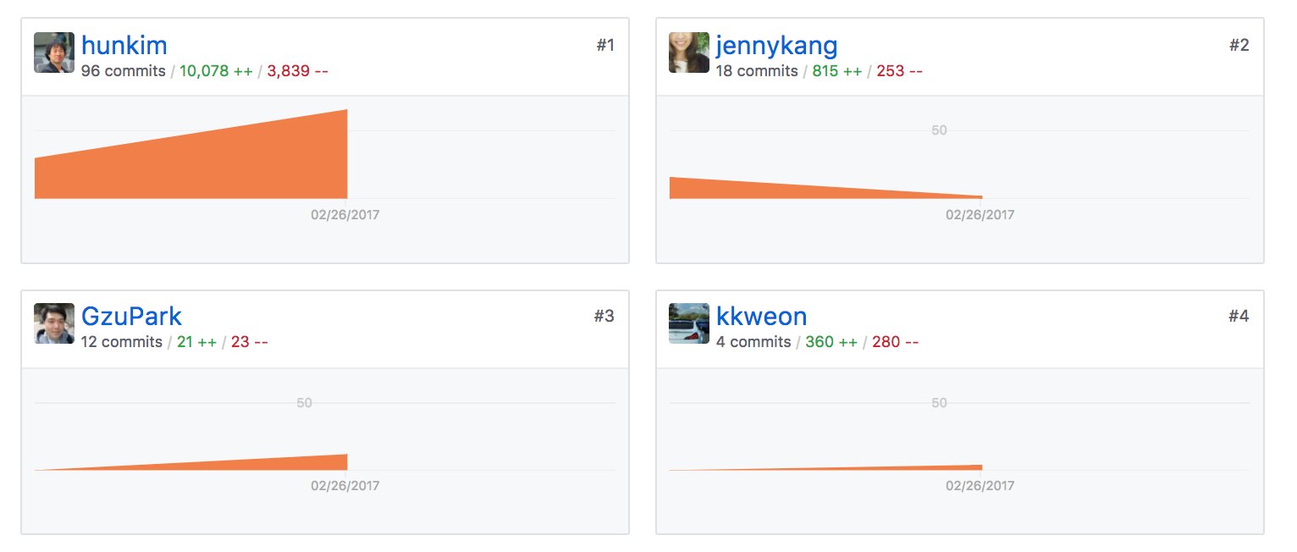
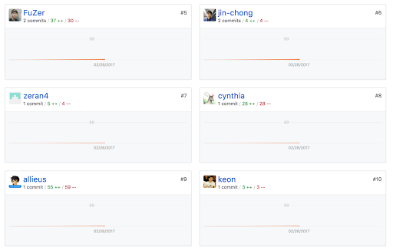
https://github.com/hunkim/DeepLearningZeroToAll/

Slide 5
Hypothesis using matrix
x₁ | x₂ | x₃ | Y
73 | 80 | 75 | 152
93 | 88 | 93 | 185
89 | 91 | 90 | 180
96 | 98 | 100 | 196
73 | 66 | 70 | 142
Test Scores for General Psychology
Notes:
\begin{pmatrix}x_1&x_2&x_3\end{pmatrix}\cdot \begin{pmatrix}w_1\\ w_2\\ w_3\end{pmatrix}=\begin{pmatrix}x_1w_1+x_2w_2+x_3w_3\end{pmatrix}

Slide 6
Hypothesis using matrix
x₁ | x₂ | x₃ | Y
73 | 80 | 75 | 152
93 | 88 | 93 | 185
89 | 91 | 90 | 180
96 | 98 | 100 | 196
73 | 66 | 70 | 142
x1_data = [73., 93., 89., 96., 73.]
x2_data = [80., 88., 91., 98., 66.]
x3_data = [75., 93., 90., 100., 70.]
y_data = [152., 185., 180., 196., 142.]
# placeholders for a tensor that will be always fed.
x1 = tf.placeholder(tf.float32)
x2 = tf.placeholder(tf.float32)
x3 = tf.placeholder(tf.float32)
Y = tf.placeholder(tf.float32)
w1 = tf.Variable(tf.random_normal([1]), name='weight1')
w2 = tf.Variable(tf.random_normal([1]), name='weight2')
w3 = tf.Variable(tf.random_normal([1]), name='weight3')
b = tf.Variable(tf.random_normal([1]), name='bias')
hypothesis = x1 * w1 + x2 * w2 + x3 * w3 + b
Test Scores for General Psychology
https://github.com/hunkim/DeepLearningZeroToAll/blob/master/lab-04-1-multi_variable_linear_regression.py
Notes:
\begin{pmatrix}x_1&x_2&x_3\end{pmatrix}\cdot \begin{pmatrix}w_1\\ w_2\\ w_3\end{pmatrix}=\begin{pmatrix}x_1w_1+x_2w_2+x_3w_3\end{pmatrix}

Slide 7
import tensorflow as tf
x1_data = [73., 93., 89., 96., 73.]
x2_data = [80., 88., 91., 98., 66.]
x3_data = [75., 93., 90., 100., 70.]
y_data = [152., 185., 180., 196., 142.]
# placeholders for a tensor that will be always fed.
x1 = tf.placeholder(tf.float32)
x2 = tf.placeholder(tf.float32)
x3 = tf.placeholder(tf.float32)
Y = tf.placeholder(tf.float32)
w1 = tf.Variable(tf.random_normal([1]), name='weight1')
w2 = tf.Variable(tf.random_normal([1]), name='weight2')
w3 = tf.Variable(tf.random_normal([1]), name='weight3')
b = tf.Variable(tf.random_normal([1]), name='bias')
hypothesis = x1 * w1 + x2 * w2 + x3 * w3 + b
# cost/loss function
cost = tf.reduce_mean(tf.square(hypothesis - Y))
# Minimize. Need a very small learning rate for this data set
optimizer = tf.train.GradientDescentOptimizer(learning_rate=1e-5)
train = optimizer.minimize(cost)
# Launch the graph in a session.
sess = tf.Session()
# Initializes global variables in the graph.
sess.run(tf.global_variables_initializer())
for step in range(2001):
cost_val, hy_val, _ = sess.run([cost, hypothesis, train],
feed_dict={x1: x1_data, x2: x2_data, x3: x3_data, Y: y_data})
if step % 10 == 0:
print(step, "Cost: ", cost_val, "\nPrediction:\n", hy_val)
0 Cost: 19614.8
Prediction:
[ 21.69748688 39.10213089 31.82624626 35.14236832 32.55316544]
10 Cost: 14.0682
Prediction:
[ 145.56100464 187.94958496 178.50236511 194.86721802 146.08096313]
...
1990 Cost: 4.9197
Prediction:
[ 148.15084839 186.88632202 179.6293335 195.81796265 144.46044922]
2000 Cost: 4.89449
Prediction:
[ 148.15931702 186.8805542 179.63194275 195.81971741 144.45298767]
https://github.com/hunkim/DeepLearningZeroToAll/blob/master/lab-04-1-multi_variable_linear_regression.py

Slide 8
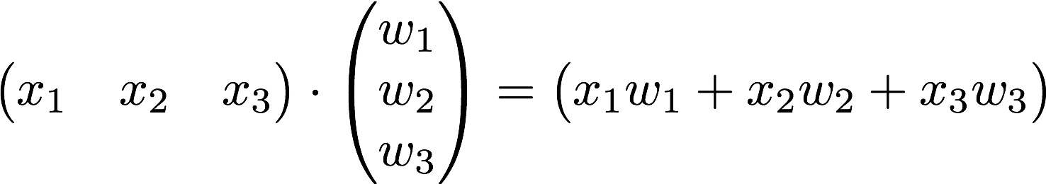

Matrix

Slide 9
Matrix
x_data = [[73., 80., 75.], [93., 88., 93.],
[89., 91., 90.], [96., 98., 100.], [73., 66., 70.]]
y_data = [[152.], [185.], [180.], [196.], [142.]]
# placeholders for a tensor that will be always fed.
X = tf.placeholder(tf.float32, shape=[None, 3])
Y = tf.placeholder(tf.float32, shape=[None, 1])
W = tf.Variable(tf.random_normal([3, 1]), name='weight')
b = tf.Variable(tf.random_normal([1]), name='bias')
# Hypothesis
hypothesis = tf.matmul(X, W) + b
https://github.com/hunkim/DeepLearningZeroToAll/blob/master/lab-04-2-multi_variable_matmul_linear_regression.py

Slide 10
import tensorflow as tf
x_data = [[73., 80., 75.], [93., 88., 93.],
[89., 91., 90.], [96., 98., 100.], [73., 66., 70.]]
y_data = [[152.], [185.], [180.], [196.], [142.]]
# placeholders for a tensor that will be always fed.
X = tf.placeholder(tf.float32, shape=[None, 3])
Y = tf.placeholder(tf.float32, shape=[None, 1])
W = tf.Variable(tf.random_normal([3, 1]), name='weight')
b = tf.Variable(tf.random_normal([1]), name='bias')
# Hypothesis
hypothesis = tf.matmul(X, W) + b
# Simplified cost/loss function
cost = tf.reduce_mean(tf.square(hypothesis - Y))
# Minimize
optimizer = tf.train.GradientDescentOptimizer(learning_rate=1e-5)
train = optimizer.minimize(cost)
# Launch the graph in a session.
sess = tf.Session()
# Initializes global variables in the graph.
sess.run(tf.global_variables_initializer())
for step in range(2001):
cost_val, hy_val, _ = sess.run(
[cost, hypothesis, train], feed_dict={X: x_data, Y: y_data})
if step % 10 == 0:
print(step, "Cost: ", cost_val, "\nPrediction:\n", hy_val)
0 Cost: 7105.46
Prediction:
[[ 80.82241058]
[ 92.26364136]
[ 93.70250702]
[ 98.09217834]
[ 72.51759338]]
10 Cost: 5.89726
Prediction:
[[ 155.35159302]
[ 181.85691833]
[ 181.97254944]
[ 194.21760559]
[ 140.85707092]]
...
1990 Cost: 3.18588
Prediction:
[[ 154.36352539]
[ 182.94833374]
[ 181.85189819]
[ 194.35585022]
[ 142.03240967]]
2000 Cost: 3.1781
Prediction:
[[ 154.35881042]
[ 182.95147705]
[ 181.85035706]
[ 194.35533142]
[ 142.036026 ]]
https://github.com/hunkim/DeepLearningZeroToAll/blob/master/lab-04-2-multi_variable_matmul_linear_regression.py

Slide 11
Lab 4-2
Loading Data from File
With TF 1.0!
Sung Kim <hunkim+ml@gmail.com>
Code: https://github.com/hunkim/DeepLearningZeroToAll/

Slide 12
https://github.com/hunkim/DeepLearningZeroToAll/

Slide 13
Loading data from file
data-01-test-score.csv
# EXAM1,EXAM2,EXAM3,FINAL
73,80,75,152
93,88,93,185
89,91,90,180
96,98,100,196
73,66,70,142
53,46,55,101
import numpy as np
xy = np.loadtxt('data-01-test-score.csv', delimiter=',', dtype=np.float32)
x_data = xy[:, 0:-1]
y_data = xy[:, [-1]]
# Make sure the shape and data are OK
print(x_data.shape, x_data, len(x_data))
print(y_data.shape, y_data)
https://github.com/hunkim/DeepLearningZeroToAll/blob/master/lab-04-3-file_input_linear_regression.py

Slide 14
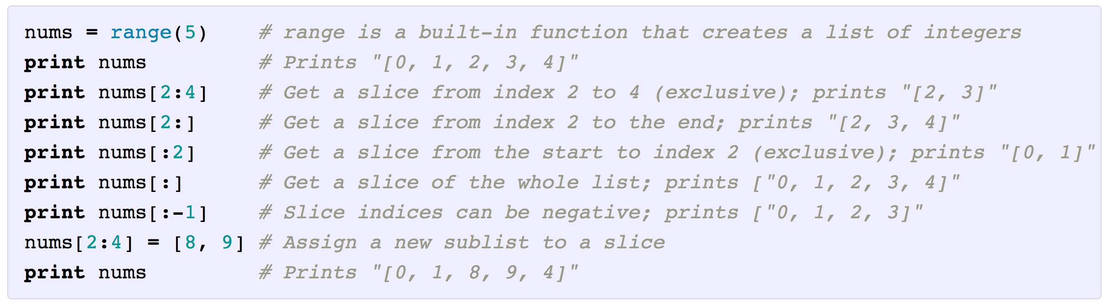
Slicing
http://cs231n.github.io/python-numpy-tutorial/

Slide 15
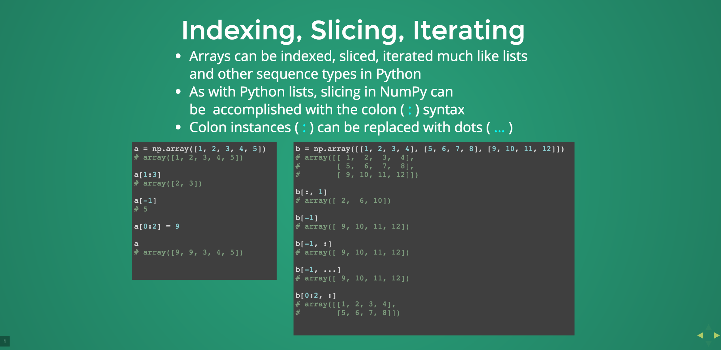
http://slides.com/wigging/numpy#/9

Slide 16
Loading data from file
data-01-test-score.csv
# EXAM1,EXAM2,EXAM3,FINAL
73,80,75,152
93,88,93,185
89,91,90,180
96,98,100,196
73,66,70,142
53,46,55,101
import numpy as np
xy = np.loadtxt('data-01-test-score.csv', delimiter=',', dtype=np.float32)
x_data = xy[:, 0:-1]
y_data = xy[:, [-1]]
# Make sure the shape and data are OK
print(x_data.shape, x_data, len(x_data))
print(y_data.shape, y_data)
https://github.com/hunkim/DeepLearningZeroToAll/blob/master/lab-04-3-file_input_linear_regression.py

Slide 17
import tensorflow as tf
import numpy as np
tf.set_random_seed(777) # for reproducibility
xy = np.loadtxt('data-01-test-score.csv', delimiter=',', dtype=np.float32)
x_data = xy[:, 0:-1]
y_data = xy[:, [-1]]
# Make sure the shape and data are OK
print(x_data.shape, x_data, len(x_data))
print(y_data.shape, y_data)
# placeholders for a tensor that will be always fed.
X = tf.placeholder(tf.float32, shape=[None, 3])
Y = tf.placeholder(tf.float32, shape=[None, 1])
W = tf.Variable(tf.random_normal([3, 1]), name='weight')
b = tf.Variable(tf.random_normal([1]), name='bias')
# Hypothesis
hypothesis = tf.matmul(X, W) + b
# Simplified cost/loss function
cost = tf.reduce_mean(tf.square(hypothesis - Y))
# Minimize
optimizer = tf.train.GradientDescentOptimizer(learning_rate=1e-5)
train = optimizer.minimize(cost)
# Launch the graph in a session.
sess = tf.Session()
# Initializes global variables in the graph.
sess.run(tf.global_variables_initializer())
# Set up feed_dict variables inside the loop.
for step in range(2001):
cost_val, hy_val, _ = sess.run(
[cost, hypothesis, train],
feed_dict={X: x_data, Y: y_data})
if step % 10 == 0:
print(step, "Cost: ", cost_val,
"\nPrediction:\n", hy_val)
# Ask my score
print("Your score will be ", sess.run(hypothesis,
feed_dict={X: [[100, 70, 101]]}))
print("Other scores will be ", sess.run(hypothesis,
feed_dict={X: [[60, 70, 110], [90, 100, 80]]}))
https://github.com/hunkim/DeepLearningZeroToAll/blob/master/lab-04-3-file_input_linear_regression.py

Slide 18
Output
# Launch the graph in a session.
sess = tf.Session()
# Initializes global variables in the graph.
sess.run(tf.global_variables_initializer())
# Set up feed_dict variables inside the loop.
for step in range(2001):
cost_val, hy_val, _ = sess.run(
[cost, hypothesis, train],
feed_dict={X: x_data, Y: y_data})
if step % 10 == 0:
print(step, "Cost: ", cost_val,
"\nPrediction:\n", hy_val)
# Ask my score
print("Your score will be ", sess.run(hypothesis,
feed_dict={X: [[100, 70, 101]]}))
print("Other scores will be ", sess.run(hypothesis,
feed_dict={X: [[60, 70, 110], [90, 100, 80]]}))
Your score will be [[ 181.73277283]]
Other scores will be [[ 145.86265564] [ 187.23129272]]
https://github.com/hunkim/DeepLearningZeroToAll/blob/master/lab-04-3-file_input_linear_regression.py

Slide 19
Queue Runners
https://www.tensorflow.org/programmers_guide/reading_data

Slide 20



filename_queue = tf.train.string_input_producer(
['data-01-test-score.csv', 'data-02-test-score.csv', ... ],
shuffle=False, name='filename_queue')
record_defaults = [[0.], [0.], [0.], [0.]]
xy = tf.decode_csv(value, record_defaults=record_defaults)
reader = tf.TextLineReader()
key, value = reader.read(filename_queue)
https://github.com/hunkim/DeepLearningZeroToAll/blob/master/lab-04-4-tf_reader_linear_regression.py

Slide 21
tf.train.batch
# collect batches of csv in
train_x_batch, train_y_batch = \
tf.train.batch([xy[0:-1], xy[-1:]], batch_size=10)
sess = tf.Session()
...
# Start populating the filename queue.
coord = tf.train.Coordinator()
threads = tf.train.start_queue_runners(sess=sess, coord=coord)
for step in range(2001):
x_batch, y_batch = sess.run([train_x_batch, train_y_batch])
...
coord.request_stop()
coord.join(threads)
https://www.tensorflow.org/programmers_guide/reading_data

Slide 22
import tensorflow as tf
filename_queue = tf.train.string_input_producer(
['data-01-test-score.csv'], shuffle=False, name='filename_queue')
reader = tf.TextLineReader()
key, value = reader.read(filename_queue)
# Default values, in case of empty columns. Also specifies the type of the
# decoded result.
record_defaults = [[0.], [0.], [0.], [0.]]
xy = tf.decode_csv(value, record_defaults=record_defaults)
# collect batches of csv in
train_x_batch, train_y_batch = \
tf.train.batch([xy[0:-1], xy[-1:]], batch_size=10)
# placeholders for a tensor that will be always fed.
X = tf.placeholder(tf.float32, shape=[None, 3])
Y = tf.placeholder(tf.float32, shape=[None, 1])
W = tf.Variable(tf.random_normal([3, 1]), name='weight')
b = tf.Variable(tf.random_normal([1]), name='bias')
# Hypothesis
hypothesis = tf.matmul(X, W) + b
# Simplified cost/loss function
cost = tf.reduce_mean(tf.square(hypothesis - Y))
# Minimize
optimizer = tf.train.GradientDescentOptimizer(learning_rate=1e-5)
train = optimizer.minimize(cost)
# Launch the graph in a session.
sess = tf.Session()
# Initializes global variables in the graph.
sess.run(tf.global_variables_initializer())
# Start populating the filename queue.
coord = tf.train.Coordinator()
threads = tf.train.start_queue_runners(sess=sess, coord=coord)
for step in range(2001):
x_batch, y_batch = sess.run([train_x_batch, train_y_batch])
cost_val, hy_val, _ = sess.run(
[cost, hypothesis, train],
feed_dict={X: x_batch, Y: y_batch})
if step % 10 == 0:
print(step, "Cost: ", cost_val,
"\nPrediction:\n", hy_val)
coord.request_stop()
coord.join(threads)
https://github.com/hunkim/DeepLearningZeroToAll/blob/master/lab-04-4-tf_reader_linear_regression.py

Slide 23
shuffle_batch
# min_after_dequeue defines how big a buffer we will randomly sample
# from -- bigger means better shuffling but slower start up and more
# memory used.
# capacity must be larger than min_after_dequeue and the amount larger
# determines the maximum we will prefetch. Recommendation:
# min_after_dequeue + (num_threads + a small safety margin) * batch_size
min_after_dequeue = 10000
capacity = min_after_dequeue + 3 * batch_size
example_batch, label_batch = tf.train.shuffle_batch(
[example, label], batch_size=batch_size, capacity=capacity,
min_after_dequeue=min_after_dequeue)
https://www.tensorflow.org/programmers_guide/reading_data

Slide 24
Lab 5
Logistic (regression) classifier
Sung Kim <hunkim+ml@gmail.com>

